Slide 1



Is the Enterprise Ready for the Cloud?
Mark Masterson
Innovation lead, troublemaker
CSC Financial Services EMEA

Slide 2
No.
Notes:
Absolutely not. But I’m also going to assert that it doesn’t really matter, and to explain why that’s so, I will need to spend some time NOT talking about cloud computing, but about business. So let’s begin by examining why I answer the question with “no”? Simon Wardley tells a great anecdote about a SaaS service that he built and sold to a company on a revenue sharing sort of basis – the ultimate in OPEX. They had to stop the program, despite earning significant revenue with it, because their internal budgeting and accounting processes couldn’t accommodate these kinds of costs

Slide 3
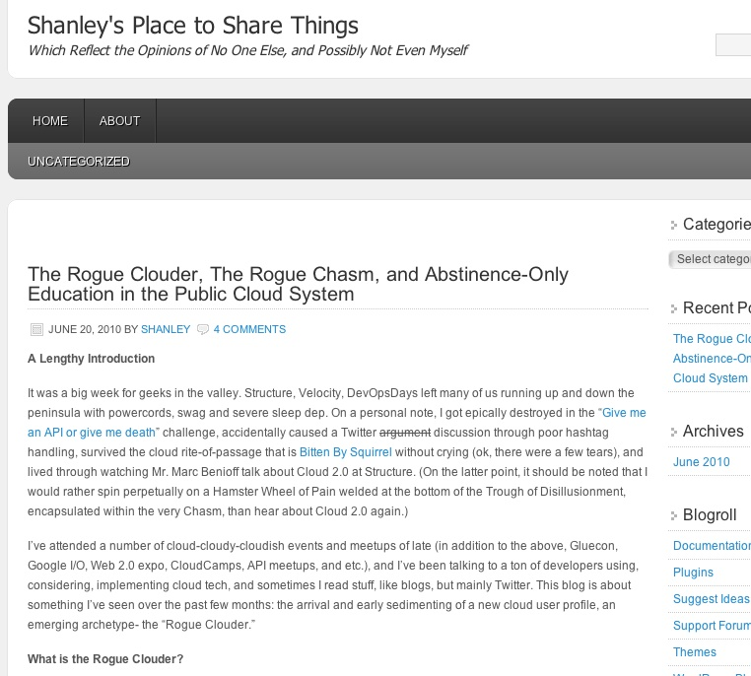

http://shanleykane.wordpress.com/2010/06/20/roguecloud/
Notes:
In a recent blog post, Shanley Kane wrote: “The point is that while the cloud generation and the aaS model has theoretically enabled a new process and ramp for adoption (try a little, pay as you go, scale up when you are ready), this is not matched by process innovations inside the enterprise that accommodate progressive, sanctioned experiments in new technology.”
She then goes on to suggest that this leads to silos and antagonism between the “rogue clouders” and the forces of the status quo, such as IT security people.

Slide 4

Viva La Revolution!
Notes:
So, I’m a really old person, unlike Shanley, and what I immediately thought of was the client / server revolution of the 80s and the 90s.

Slide 5
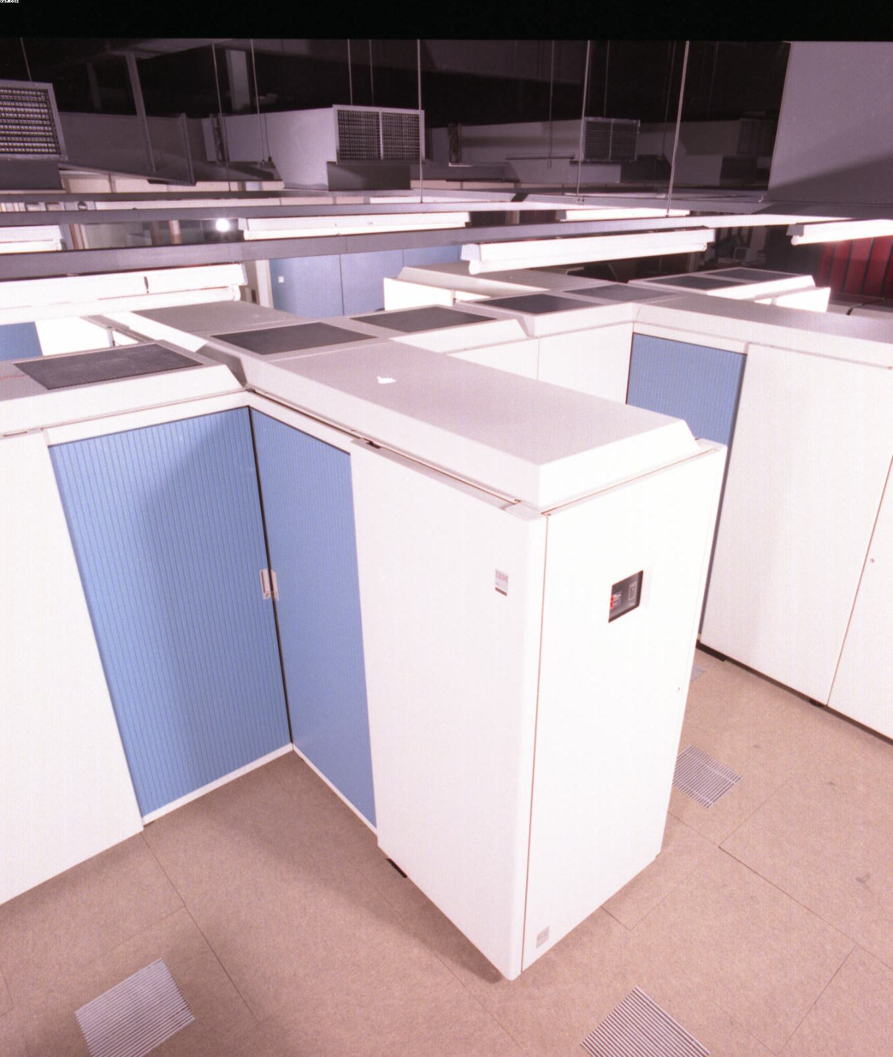
Notes:
We thought we were going to destroy the “glass house”, with its completely centralised and inflexible high priests of the mainframe…

Slide 6

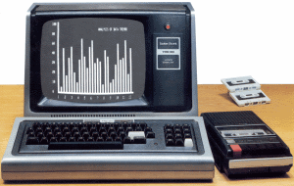
Notes:
And usher in a brave new world where every division, business unit, branch office, project, indeed, worker could and would have their own portion of compute power to innovate with. (Extra props if you recognise the Trash-80 in this pic). We were the rogue client / servers to Shanley’s rogue clouders. And we had exactly the same issues: questions of control and governance vs. innovation, growth, and (as Shanley puts it) making enough money to buy lots of ponies.

Slide 7

Notes:
And you younger people may be thinking that this sounds very similar to the somewhat more recent battles you’ve fought (and continue to fight) to bring open source technologies into the enterprise as well.

Slide 8
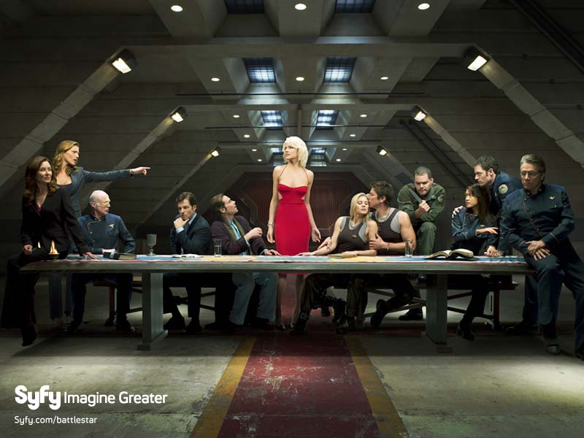
Notes:
This sort of thing is amusing to old people, because it confirms one of their most profound (and hardest-earned) bits of wisdom: this has all happened before, and will happen again.

Slide 9
Utility Services
Commodity
Product
Ubiquity
Custom built
Innovation
Certainty
Notes:
And that’s because there are some distinct and powerful forces at work to make it so. This is (a version of) Simon Wardley’s commoditisation curve, and it is one of them. I won’t try to explain it in detail – if you’re not familiar with it, you owe it to yourself to catch one of Simon’s talks (either live or on YouTube or whatever) to learn more about it. The only thing I need to say is that it describes how all business activities are moving along this curve, on their way from being a new innovation towards becoming a commodity good or service. And that those things that become commodities, in turn, enable the next wave of innovation.

Slide 10
Risk = likelihood (failure) * cost (failure)
The Handbook Of Information Security
http://books.google.com/books?id=0RfANAwOUdIC&pg=PA800&lpg=PA800&dq=risk+exposure+re+formula&source=web&ots=pENn1no-zn&sig=Xe72BRymob2ftXlp4CciUr-ly-Y&hl=en&ei=QquNSfLdMob00AXB4OGcCw&sa=X&oi=book_result&resnum=5&ct=result
Notes:
Another force that affects business activities is this formula. In its classic form, it is used to define the components of risk: there is a famous version of it in the Handbook Of Information Security, for example. But it more broadly affects all kinds of business decisions, not just IT-related ones, because all business decisions are characterised by risk. All of the buzzwords that geeks love to hate, such as ROI or cost/benefit analyses, are really just ways of examining risk. And over the last 50 years or so, partly motivated by (what were once profound innovations in, and what are now purely commodities) IT, businesses all over the world have almost exclusively focused their attention on one half of the formula: on reducing the likelihood of failure.

Slide 11
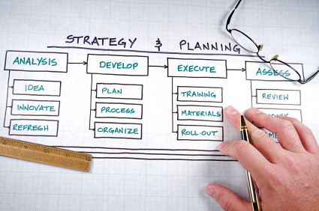
Notes:
Almost any business methodology you can think of, whether IT related, such as ITIL or CMMI, or more purely business related, such as Six Sigma or the PMIP efforts, etc. is relentlessly and obsessively focused on reducing the likelihood of failure. The way new efforts get described, estimated and proposed are all driven by a desire to minimise the likelihood of failure.

Slide 12

Notes:
Seen from this perspective, almost all modern business processes, from accounting to supply chain management, as well as the body of governance and regulation that one runs smack into whether trying to push Linux or the use of the public cloud in the enterprise; all these things are primarily focused on minimising risk by reducing the likelihood of failure.

Slide 13

Notes:
Indeed, I would go so far as to suggest that when economists talk about the effects of IT since the 1960s on overall business productivity, that this is really what’s being discussed: an increase in repeatable results with the fewest possible resources. Reducing the likelihood of failure.

Slide 14
Utility Services
Commodity
Product
Ubiquity
Custom built
Innovation
Certainty
Notes:
However, Simon likes to point out that different business techniques and methodologies are appropriate at different places on this curve. Something like Six Sigma is good, for example, at managing the production of commodities, but it sucks at managing innovation – indeed, will typically kill innovation stone cold dead. By the same token, techniques that are appropriate in the innovation phase often suck at producing commodities.

Slide 15

Utility Services
Commodity
Product
Ubiquity
Custom built
Innovation
Certainty
Notes:
Yet because of this relentless focus on reducing the likelihood of failure, for nearly half a century the focus of business improvement efforts has been on perfecting approaches that are only appropriate at the commodity end of the spectrum. Businesses have placed all their chips here; they are all in on this end of the curve. And without being necessarily able to articulate why, they have been feeling for some time that this imbalance is bad.

Slide 16

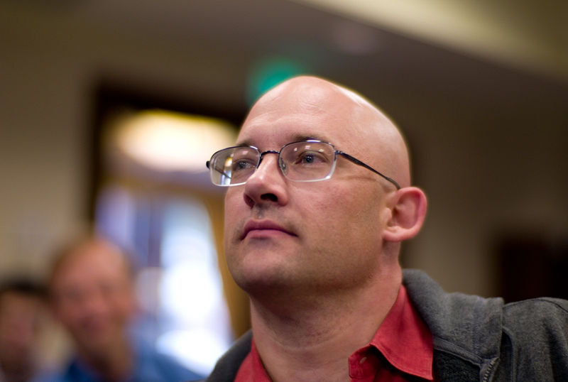
http://www.herecomeseverybody.org/
Photo by Joi Ito: http://en.wikipedia.org/wiki/File:ClayShirkyJI1.jpg
Notes:
And now we’re getting to why it doesn’t matter very much that enterprises aren’t ready for the cloud. Because, as is the nature of things, driven by the disadvantages and ill effects of this imbalance, the system is in the process of moving towards a new equilibrium. And it’s doing that by finding ways to shift focus to the other half of the equation: to find ways to reduce the cost of failure, rather than the likelihood. Clay Shirky, pictured here, talks about one example of that in his excellent book “Here Comes Everybody”. He explains how this formula, and the advantages to be derived from a drastic reduction in the cost of failure, are some of the primary benefits, as well as drivers of the emergence of open source means of production. But we see this elsewhere, in slightly more subtle manifestations as well, such as the reaction to so-called “waterfall” methods of software production that agile software development efforts represent – or even in the lean manufacturing ideas of the 80s and 90s.

Slide 17

Notes:
Finding ways to reduce the cost of failure turns out to be a tremendously powerful thing. It allows an organisation (or an individual) to increase their tolerance for failure. That, in turn, creates a capability to take more frequent (lower cost) risks, to experiment. To innovate. To grow.
On a deeper level, it’s about opportunity cost in its purest form. Opportunity cost is that which you give up in return for the choice that you make. Game theory explains how in decision making scenarios, successful players strive to defer the decision as long as possible, with the intent of gathering the maximum amount of context information as possible, so as to make the most informed decision possible. But many factors can come into play to force decisions at an earlier point – this is a key part of the insight of the costs of “waste” embedded in value creations processes of lean manufacturing theory. Assets (inventory) that are not immediately consumed in the value creation process cost something to carry around. Their existence is always a factor that determines the point in time when a decision must be made. The sunk costs of IT assets are this kind of waste – once committed, those assets become a limiting factor in all future decisions

Slide 18
Utility Services
Commodity
Product
Ubiquity
Custom built
Innovation
Certainty
Notes:
The opportunity for society that this suggests is one where organisations (particularly large ones, aka "enterprises") regain more balance between activities at both ends of Simon’s curve.

Slide 19
Cloud computing is one of the things that reduces the cost of failure.
Notes:
Indeed, I would suggest that it might be the single most important such thing, but I’m at OSCON, and I might get lynched if I didn’t at least pretend that I thought open source was just as important.

Slide 20
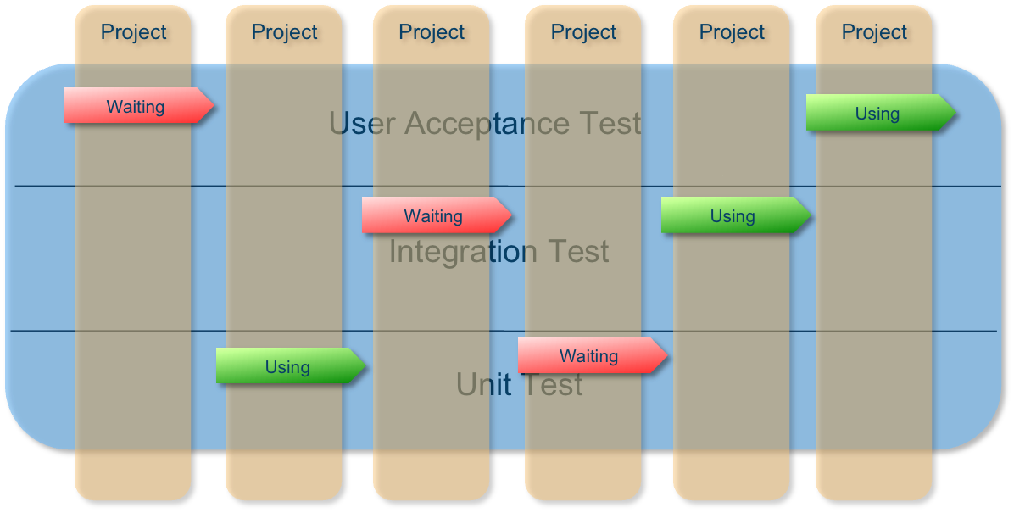
Notes:
So why do I think that? That’s the subject of a much longer talk, but in a nutshell, it frees an enterprise from the burden of IT (and the inability to fail cheaply that IT implies). This picture, for example, is typical of any large enterprise – it’s a picture of allocation of test resources. In the banks and insurance companies I work at, these are mainframe environments, but what's universal is that they are a highly constrained resource. I have seen entire enterprises suffering from one project not meeting it’s presumed date for use of the integration test environment – a cascading chain reaction of delays for other, waiting projects cost hundreds of millions of dollars – if added up.

Slide 21
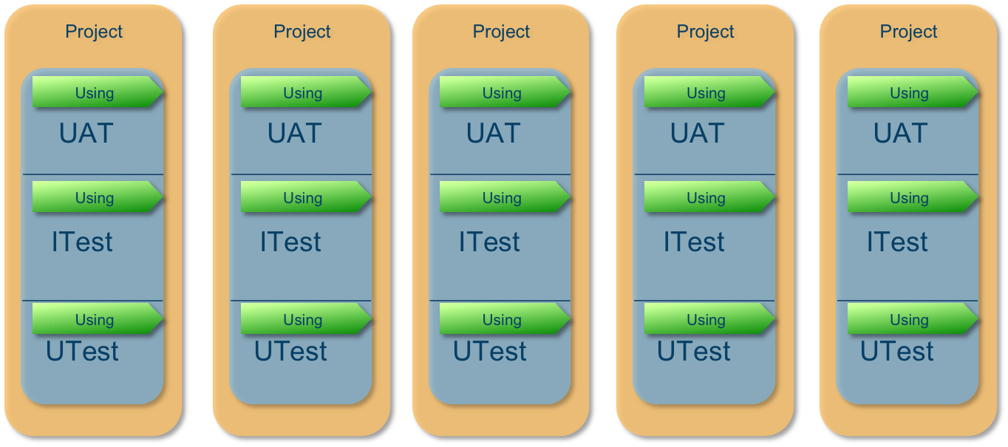
Notes:
Instead of contending for limited resources, the ability to allocate essentially infinite resources to any project, at astonishingly low costs, is a game changer. This is where the opportunity cost argument becomes visible – the cloud can enable an enterprise to behave in a profoundly more agile, innovative way. That fundamentally changes the risk variable in the perennial question: “can we afford to experiment with this, to see if it might bring us some value?”. And it makes the entire value chain inside an enterprise leaner, and faster – ideas can move from brainstorming to market much faster. It is a world in which every idea, no matter how speculative, can be allocated its own, dedicated IT stack. It is a world in which the IT choices that I make today do not place unnecessary restrictions of the choices I will be able to make tomorrow. And this argument holds true at any level of the SPI stack, whether infrastructure, platform or software as a service.

Slide 22

Notes:
this in turn holds the promise of unleashing the next great Age -- not just in IT, but business in general -- by allowing us to shift our focus from "productivity" to "growth". To move towards more balanced organisation that can not only make more money (be more commercially successful) but also be a better one to work for, a healthier place to be.

Slide 23

Scene from Monty Python and the Holy Grail
Copyright ® 2000-2009 New Media Broadcasting Company, Inc. All Rights Reserved. http://pythonline.com/
Notes:
Some enterprises will reject this thinking. Some will embrace it. Some are less ready than others, and will deny that what I am asserting is happening to them is, in fact, happening. “It’s only a flesh wound,” they say to me. These organisations will continue to place their bets on the things that they have come to know, love and believe they understand. Others will seek competitive advantage by placing bets elsewhere, and will begin to change as a result. No one can ever predict the future, but I know where I’m placing my bets.

Slide 24
Thanks.
Ping me @mastermark.
All uncredited photos are public domain (AFAIK) or licensed by me from ©iStockphoto.com
Notes:
Thanks for your time.

